Slide 1
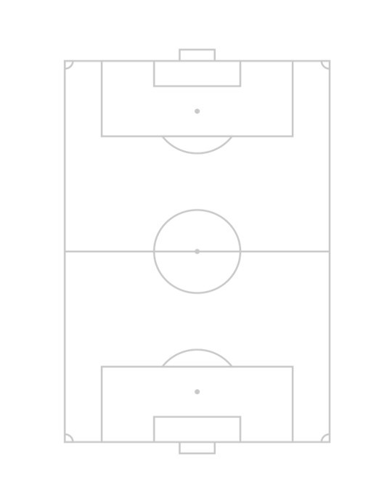

S1
CF
ST
S2
SS
LW
LAM
CAM
RAM
RW
S3
LM
LCM
CM
RCM
RM
S4
LWB
LDM
CDM
RDM
RWB
S5
LB
LCB
CB
RCB
RB
S6
GK
S7

Slide 3


